Slide 1


Analysis of Sales Prediction Dataset
Vaishnavi S

Slide 2


Contents
Average amount spent on TV advertising
Correlation b/w radio advertising expenditure and sales
Advertising medium with the highest impact
Training a Linear Regression Model
Prediction for a new set of advertising expenditure
Performance of the model post normalization
Impact on the model when TV is excluded

Slide 3
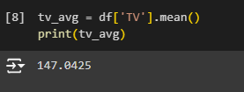
Q1. Average amount spent on TV advertising
$147.0425 was spent on TV Advertising on an average.

Slide 4
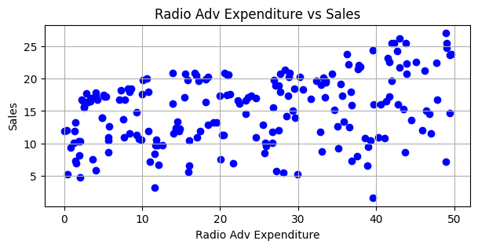
Q2. Correlation b/w radio advertising expenditure and sales
The scatter plots suggests a relationship that is not exactly linear, but somewhat monotonic. Hence, using Spearman's Correlation is the best.

Slide 5
Analysis
The correlation between Radio Advertising Expenditure and Sales is 0.34001
This indicates that there is a positive relationship between the two features, but it is weak or not very consistent, i.e., an increase in Radio Advertising Expenditure might lead to a slight increase in sales, but it might not increase by a huge margin in a consistent manner.

Slide 6

Q3. Advertising medium with the highest impact
TV has the highest correlation with Sales
It can be seen that advertising via TV has the highest impact on sales. Thus, it can be understood that people are most influenced by TV advertisements and hence sellers can strategize accordingly to boost their sales.

Slide 7
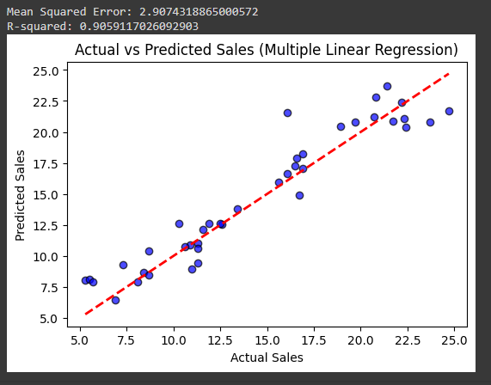
Q4. Training a Linear Regression Model

Slide 8
Analysis
Most of the data points in the Actual vs Predicted plot are scattered around the regression line, showing that the model is fairly accurate.
However, deviations increase as the Actual Sales value increases. This might imply that the model's accuracy decreases with an increase in the Actual Sales value.
Therefore, the model displays decent performance at lower and intermediate values of Actual Sales but needs improvement at higher levels.

Slide 9

Q5. Prediction for a new set of advertising expenditure
The predicted value of sales for the given expenditure across different advertising mediums is $19.73.

Slide 10

Q6. Performance of the model post normalization

Slide 11
Analysis
The value of Mean Squared Error and R-squared error of the model increases from 2.409 and 0.874 respectively, without normalization, to 2.907 and 0.905 respectively, with normalization.
Normalization results in the scaling of all features in the dataset. This might lead to skewed results post normalization, since scaling some features might have an adverse effect on the overall performance.
Another reason for the slight increase can be the linear relationships among the features, which get distorted after normalization.

Slide 12

Q7. Impact on the model when TV is excluded

Slide 13
Analysis
TV has the highest correlation with Sales, compared to the other advertising mediums. This shows that TV is the medium that is used to reach a broad range of audience and has the most impact on sales.
Thus, excluding TV from the linear regression model impairs the predictive power of the model. It also increases the error values of the model. As expected, the MSE and R-Squared Error values see a massive spike when TV is excluded.

Slide 14
Thank You

